Slide 1
The Vocal Pedagogy Workshop Stephen F. Austin, M.M., Ph.D. Associate Professor of Voice and Vocal Pedagogy School of Music University of North Texas
Vocal Health

Slide 2
The Vocal Pedagogy Workshop Session V – Vocal Health
How do we keep the voice healthy?
Avoid known irritants
Chemicals; household, garden, workplace
Cigarette smoke – even secondhand
Molds, mildews, other allergens

Slide 3
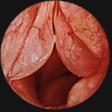
Reinke’s Edema

Slide 4
The Vocal Pedagogy Workshop Session V – Vocal Health
How do we keep the voice healthy?
Provide a humid environment
Avoid long exposures to dry air
Air travel
Heated/air conditioned bedrooms
Keep your body hydrated
Dr. Van Lawrence: “Pee Pale”

Slide 5
The Vocal Pedagogy Workshop Session V – Vocal Health
How do we keep the voice healthy?
Avoid excessive diuretics when possible
Caffeine – coffee, tea, soft drinks, chocolate!
Avoid Overuse/Misuse
Too much singing
Talking in noisy environments (cars, planes, etc.)
Cheerleading, choir directing, sports events

Slide 6
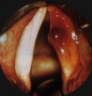
Hematoma

Slide 7
The Vocal Pedagogy Workshop Session V – Vocal Health
What do I do when I’m really sick?
Allergies/Colds
Nose Sprays
Pediatric strength Afrin. Limit to 3-5 days. Alternate sides.
Topical nasal steroids for seasonal symptoms: Beconase, Vancenase, Rhinocort, Nasalide, etc.

Slide 8
The Vocal Pedagogy Workshop Session V – Vocal Health
What do I do when I’m really sick?
Allergies/Colds
Antihistamines for allergy symptoms
When topical applications are not enough
Potentially drying; find one that isn’t
Some sedation problems
Over-the-counter brands are the worst
Chlor-trimeton, Polaramine, Dimetate, etc.
Many prescription alternatives: Seldane, Hismanol, Clariton, many new ones.

Slide 9
The Vocal Pedagogy Workshop Session V – Vocal Health
What do I do when I’m really sick?
Allergies/Colds
Decongestants; antihistamines do not control nasal congestion, use a decongestant too.
Sometimes both are included: potentiates drying effects and counteracts the sedation issues:
Seldane-D, Claritin-D, etc.
May cause mild stimulatory side effects: insomnia and tachycardia

Slide 10
The Vocal Pedagogy Workshop Session V – Vocal Health
What do I do when I’m really sick?
Allergies/Colds
Mucolytic Agents
Counteract drying effect of antihistamines and decongestants
Liquefy mucus and increase the output of thin respiratory tract secretions
Guaifenesin is a common mucolytic expectorant: found in Mucinex, Robitussin, Humibid, etc.
Combined with a decongestant in: Entex and others

Slide 11
The Vocal Pedagogy Workshop Session V – Vocal Health
What do I do when I’m really sick?
Sinusitis
Chronic low grade infection can lead to postnasal drip and throat clearing
May produce nasal discharge, obstructions, etc. that can interfere with performing
Must be managed medically
Chronic conditions can be addressed surgically

Slide 12
The Vocal Pedagogy Workshop Session V – Vocal Health
What do I do when I’m really sick?
Laryngitis with vocal fold injury
Usually result of trauma
Cough, sneeze, yell – a singular event!
Vocal fold inflammation
Mucusol disruption or hemorrhage
Voice use is contraindicated
Often seen in premenstrual women using aspirin
Optimal therapeutic approach in not clear

Slide 13
The Vocal Pedagogy Workshop Session V – Vocal Health
What do I do when I’m really sick?
Laryngitis without vocal fold injury
Vocal fold edema resulting from infectious or non-infectious causes
Voice rest is not necessarily indicated
Result from overuse, misuse and many URI
Treatment includes: selective voice use, hydration, mucolytics, corticosteroids, etc.
No whispering!

Slide 14
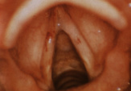
Acute Laryngitis

Slide 15
The Vocal Pedagogy Workshop Session V – Vocal Health
What do I do when I’m really sick?
Medications: Many common drugs have effects on the voice. Never take them without consulting an ‘in the know’ physician.

Slide 16
The Vocal Pedagogy Workshop Session V – Vocal Health
What do I do when I’m really sick?
Medications: Analgesics
Aspirin is contraindicated in professional voice users.
Causes platelet dysfunction
Predisposes to vocal fold hemorrhage
Acetaminophen is best substitute (Tylenol)

Slide 17
The Vocal Pedagogy Workshop Session V – Vocal Health
What do I do when I’m really sick?
Medications: Antibiotics
Widely over-prescribed and overused
No use for viral infections, only bacterial
Only upon a doctor’s recommendation
When prescribed the full course should be taken

Slide 18
The Vocal Pedagogy Workshop Session V – Vocal Health
What do I do when I’m really sick?
Medications: Antitussives
Coughing is a serious concern
Cough suppression is not necessarily the goal
‘Productive’ cough is vital for healing
Many contain antihistamines and are drying
Those that contain guaifenesin are helpful

Slide 19
The Vocal Pedagogy Workshop – Session V: Vocal Health Session V – Vocal Health
What do I do when I’m really sick?
Medications: Antihypertensive Agents
Most have some drying effect
Often prescribed with diuretic agents that also promote dehydration
If dryness is severe alternative chemicals should be sought

Slide 20
The Vocal Pedagogy Workshop Session V – Vocal Health
Hormones in the singer
Most common hormonal problem in post pubertal males are related to ingestion of anabolic steroids
Common amongst athletes
Many health risks; liver, brain tumors
Vocal symptoms include a lowering and coarsening of the voice

Slide 21
The Vocal Pedagogy Workshop Session V – Vocal Health
Hormones in the singer
Most common hormonal problem in post pubertal females are related to monthly ovarian cycle.
Most in immediate pre-menstrual period
Loss of range, fatigue, slight hoarseness
Due to engorgement of the vf

Slide 22
The Vocal Pedagogy Workshop Session V – Vocal Health
Hormones in the singer
Menopause
Menopause is associated with changes in the laryngeal mucosa.
Register transition difficulties
Breathiness, weakness, lack of flexibility, lack of support, loss of range, change in vibrato, pitch inaccuracies

Slide 23
The Vocal Pedagogy Workshop Session V – Vocal Health
Hormones in the singer
Menopause
Post-menopause pitch drop due to little or no estrogen secretions.
However, ovaries continue to produce androgens (virilization).
35-40 yo performers should have baseline estrogen levels for later reference.

Slide 24
The Vocal Pedagogy Workshop Session V – Vocal Health
Hormones in the singer.
Menopause.
Replacement therapy should be guided by a gynecologist, endocrinologist, and a laryngologist.
Androgens should not be given to a singer if there is a reasonable therapeutic alternative.
Androgens are found in some European birth control pills.

Slide 25
The Vocal Pedagogy Workshop Session V – Vocal Health
Hormones in the singer.
Hypothyroidism
Thyroid gland regulates protein synthesis and tissue metabolism.
Thyroid disorders are common in the population (<4%).

Slide 26
The Vocal Pedagogy Workshop Session V – Vocal Health
Hormones in the singer.
Hypothyroidism
Symptoms:
Hoarseness
Vocal fatigue
Muffling of the voice
Vocal fatigue

Slide 27
The Vocal Pedagogy Workshop Session V – Vocal Health
Hormones in the singer.
Hypothyroidism
Symptoms:
Loss of range
Feeling of a lump in the throat
Can occur when tests are within the low-normal range.

Slide 28
The Vocal Pedagogy Workshop Session V – Vocal Health
Hormones in the singer.
Hypothyroidism
Increased fluid in lamina propria.
Surgical complications are significant:
Recurrent and superior laryngeal nerves pass through the thyroid gland
Surgery can severe the nerves; paralysis

Slide 29
The Vocal Pedagogy Workshop Session V – Vocal Health
Gastric Reflux (GERD)
Stomach contents spill out over the larynx.
Gastric acid irritation of the musosa
High incidence in voice complaints
Satoloff (1991) 50% of voice patients
Koufman (1996) 78% with hoarseness

Slide 30
The Vocal Pedagogy Workshop Session V – Vocal Health
Gastric Reflux (GERD)
Symptoms:
Morning hoarseness
Prolonged warm-up time
Halitosis
Excessive phlegm
Frequent throat clearing
Dry mouth

Slide 31
The Vocal Pedagogy Workshop Session V – Vocal Health
Gastric Reflux (GERD)
Symptoms:
Coated tongue
Sensation of a lump in the throat
Throat tickle
Dysphagia
Chronic sore throat
heartburn

Slide 32
The Vocal Pedagogy Workshop Session V – Vocal Health
Gastric Reflux (GERD)
Physical exam:
Erythema (reddening) & edema (swelling) of mucosa around the arytenoids, false folds and posterior portion of the true folds

Slide 33
The Vocal Pedagogy Workshop Session V – Vocal Health
Gastric Reflux (GERD)
Diagnosis:
Examination by gastroenterologist
Ph monitor (24 hours)
My diagnosis: Assume that you have it, treat it and save yourself $$!

Slide 34
The Vocal Pedagogy Workshop Session V – Vocal Health
Gastric Reflux (GERD)
Rx
Elevate the head of the bed 6 inches
Antacids at bedtime
No eating 3 to 4 hours before bed
Avoid coffee and alchohol
Prilosec, Privicid, Nexium, etc.

Slide 35
The Vocal Pedagogy Workshop Session V – Vocal Health
Vocal Nodules
Benign growths on vibrating margin of the vocal folds.
Usually bilateral and symmetric.
Caused by chronic, forceful vf contact.

Slide 36
The Vocal Pedagogy Workshop Session V – Vocal Health
Vocal Nodules
Occur at point of maximum contact force; the midpoint of membranous vf.
Increases mass and stiffness.
Always result of abuse in speaking or singing voice.

Slide 37
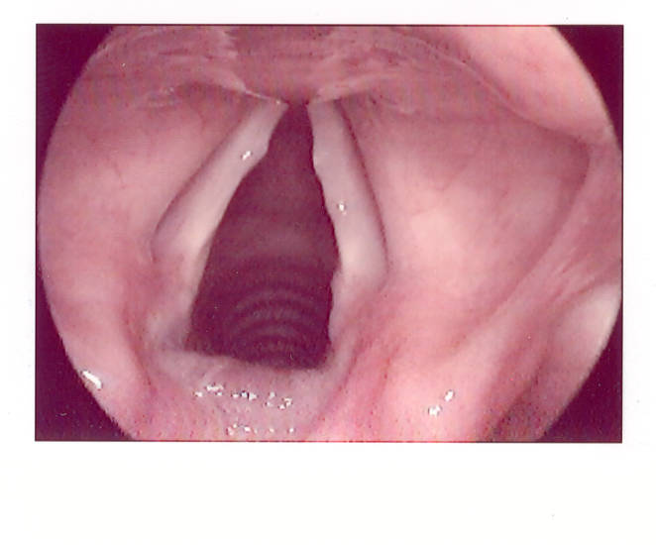
The Vocal Pedagogy Workshop Session V – Vocal Health Nodules

Slide 38
The Vocal Pedagogy Workshop Session V – Vocal Health
Vocal Nodules
Symptoms:
A change in vocal quality for new case
Breathiness
Loss of range
Vocal fatigue
Aphonia in certain parts of the range

Slide 39
The Vocal Pedagogy Workshop Session V – Vocal Health
Vocal Nodules
Often confused with cysts and other lesions without a proper diagnosis:
Strobovideolaryngoscopic exam
Recent onset nodules will resolve with voice therapy (90%).
Old nodules do not respond to therapy, but therapy should be done prior to surgery.

Slide 40
The Vocal Pedagogy Workshop Session V – Vocal Health
Vocal Nodules
Any surgical procedure can leave a scar, and a scar means dysfunction.
Vocal fold stripping is absolutely considered malpractice today.

Slide 41
Vocal Health Web Sites
http://www.bgsm.edu/voice/
http://www.hopkinsmedicine.org/voice/
http://www.voice.meei.harvard.edu/disorders/
http://www.ncvs.org/ncvs/info/vocol/rx.html

