Slide 1
The ‘voce chiusa’ : Out of the darkness into the bright
Stephen F. Austin, M.M., Ph.D.
Associate Professor of Voice
University of North Texas, USA

Slide 2
Voce chiusa
It’s everywhere…

Slide 3
Well, not so much…
Schumann
Fauré
Sondheim/Lapine

Slide 4
Voce chiusa:
Premise 1: the historical concept of ‘chiaroscuro’ is not likely to happen without intentional focus to establish the articulatory postures that allow it to occur-there are notable exceptions!
Premise 2: by focusing on the ‘dark side’ for a time, a singer can establish a resonance scheme that is perceived as appropriately balanced: dark and bright
Premise 3: there has always been a resistance to the process due to a temporary distortion which leads to this balance

Slide 5
Richard Miller, The Structure of Singing, 1986
“There can be little doubt that in desirable ‘closed voice’ (voce chiusa), a timbre that should prevail throughout the singing voice regardless of range, as opposed to ‘open voice’ (voce aperta), there is a stabilized laryngeal position – relatively low – and a somewhat widened pharynx. These conditions together with proper vowel modification (aggiustamento) produce the so-called ‘covered sound’ of the upper range.”

Slide 6
Right connections:
One cannot separate the concept of ‘voce chiusa’ from the concept of the stable laryngeal posture
Long list of distinguished authors who have written about this

Slide 7
Edmund Meyer, The Renaissance of Vocal Art, 1902
“For artistic tone, the soft palate must be high, the larynx must be low, and the throat and mouth allowed to form, not made or compelled. . . The larynx must be low in adjustment for the production of beautiful tone, but it must never be locally adjusted.”

Slide 8
Charles Amable Bataille, Nouvelles recherches sur la phonation, 1861
“Moderate lowering of the larynx has the certain result of giving the voice suppleness and power, thereby encouraging the enlargement of its natural limits.”

Slide 9
Enrico Delle Sedie, Esthetics of the Art of Singing, 1885
“When the larynx is so raised we may emit high sounds, but thin and shrill. It is true that we are disposed to raise the larynx when we want to emit high sounds, but if we would closely observe the timbre, we would recognize that they are thin, contracted and shrill.”

Slide 10
Julius Stockhausen, A Method of Singing, 1884
“The dangerous tendency of the larynx to rise to the position it takes in speaking must be carefully avoided.”

Slide 11
Julius Stockhausen, A Method of Singing, 1884
“. . . It is only with a fixed position of the larynx, and with the right use of the two chief qualities of sound, that a beautiful, well-rounded whole can be produced.”

Slide 12
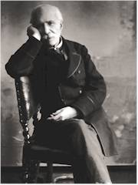
Manuel Garcia II (1805-1906)
1832 appointed to Paris Conservatory
Central figure in 19th C pedagogy
Famous pupils:
Battaille
Stockhausen
Malibran
Marchesi
Lind

Slide 13
Manuel Garcia II (1805-1906)
…the human voice is, in the largest sense, composed of the different registers:
Chest Falsetto-head
And two timbres:
Clear timbre
Sombre timbre

Slide 14
Manuel Garcia II (1805-1906)
“When the larynx produces a tone, the pharynx takes possession of it as soon as it is emitted and modifies it. Mémoire sur la voix humaine, 1840
Clear timbre
Offers brilliance and can allow power
Carried to exaggeration makes the voice shrill and yelping

Slide 15
Manuel Garcia II (1805-1906)
“When the larynx produces a tone, the pharynx takes possession of it as soon as it is emitted and modifies it. Mémoire sur la voix humaine, 1840
Sombre timbre
Gives the voice roundness
Penetration
Modifies the falsetto into the ‘head’ register

Slide 16
Manuel Garcia II (1805-1906)
Sombre timbre
AKA voce chiusa, voix sombrée ou couverte, closed timbre
Timbres result of the shape of the pharynx
If the larynx rises – clear timbre
If the larynx remains low – sombre timbre

Slide 17
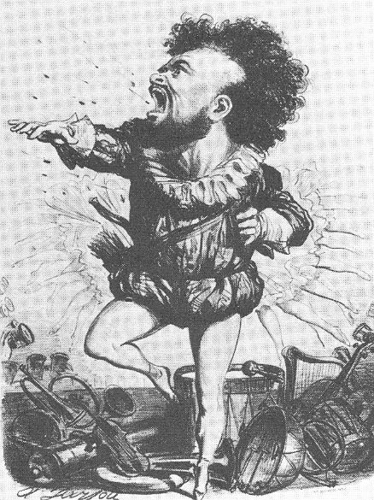
Changing Traditions
Gilbert-Louis Duprez (1806-96)
1837 – Paris
Replaced Nourrit as Arnold in Rossini’s Guilliame Tell
Do di petto
Learned the technique in Italy

Slide 18
New expectations
“After Duprez, the ut de poitrine became a requirement for the Romantic tenor high C, then or now, for the success or failure of tenors.” Stark: Bel Canto: A History of Vocal Pedagogy

Slide 19
Voix Sombrée!
June, 1840 – Diday and Pétrequin reported to the Académie des Sciences on the subject of timbre and laryngeal position as related to Duprez’s do di petto.
Voix sombrée ou couverte (dark and covered)
November, 1840 – Garcia presented his theories to the academy
Garcia claimed to have been teaching the lowered laryngeal posture and ‘covered tone’ since 1832.

Slide 20
Voix Sombrée!
Used for register unification
Female chest/middle voice
Male high voice “do di petto”
Long history of teaching this method since Garcia

Slide 21
Voix Sombrée!
Attention to the laryngeal posture is controversial
‘local effort’!
‘localized focus’! It’s not ‘natural’!
Vowel color can be utilized: [o], [u] without mention of the larynx
Source of much of the controversy throughout history

Slide 22
Voix Sombrée!
Responsible for the absence of ‘big voices’
Secret to ‘free’ singing
It is counterintuitive that to lead your students to sing bright you have to teach dark… BUT IT IS TRUE!

Slide 23
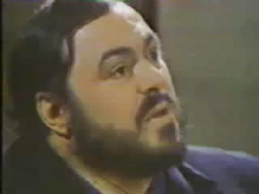

Slide 24
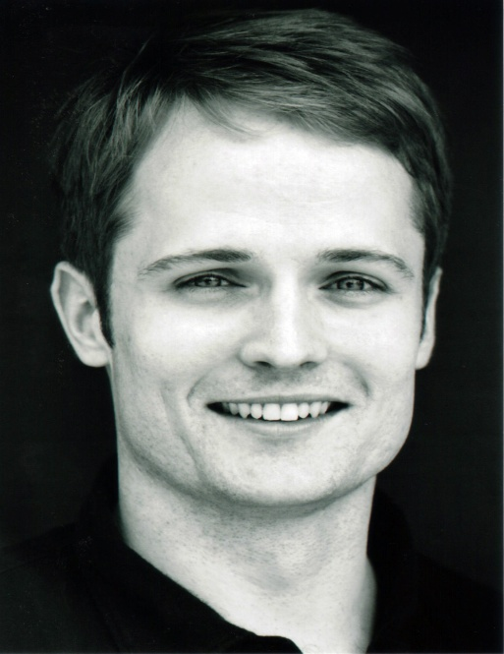
Jonathan Yarrington, tenor
-2005 Met Audition

Slide 25
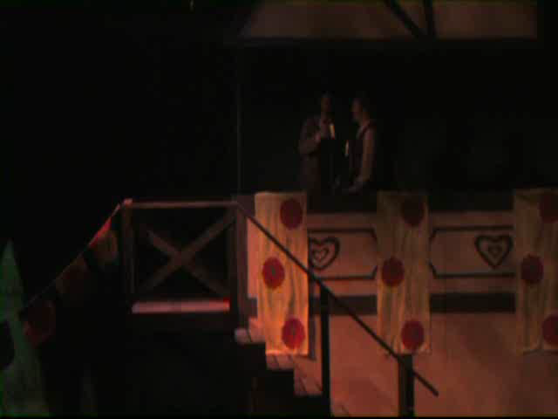

Slide 26
Others:
Il est doux
Tu che di gel
Rossini

Slide 27
How do you teach ‘chiaroscuro’?

Slide 28
Low larynx:
Indirect:
‘Singing on the inhalation of the tone’
Vennard ‘yawn-sigh’
Immitation
Vowel: [o] and [u]
Direct
Observe laryngeal position: tactile, visual
Best: All the above!

